Slide 1
Picks Project
Florin Dascalu

Slide 2
General Info
The purpose of project is to create categories, to upload images for every category, to add them to the basket and then, to download them in zip format file
The application can also to filter images in every category
Only .jpg, .jpeg and .png file are supported
App implemented cache and cookies policy
Picks was deployed to Microsoft Azure under App Service. CI and CD in Azure DevOps was implemented and in the operating environment, Azure's SQL Database was used.
Note: to run this project outside Microsoft Azure environment, it is necessary to create a DataBase named Picks.
Built on: .NET Platform (ASP .NET Core MVC) in frontend and .NET Core and C# in backend, Entity Framework for Microsoft SQL database
Used: JQuery, Twitter Bootstrap, JavaScript, Browser support: Google Chrome

Slide 3
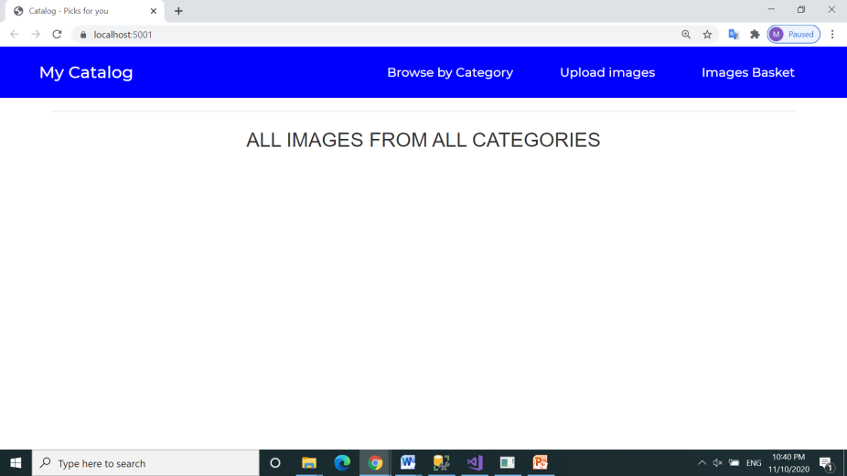
Run first the “Pick.Web” project
Click on Upload images link

Slide 4
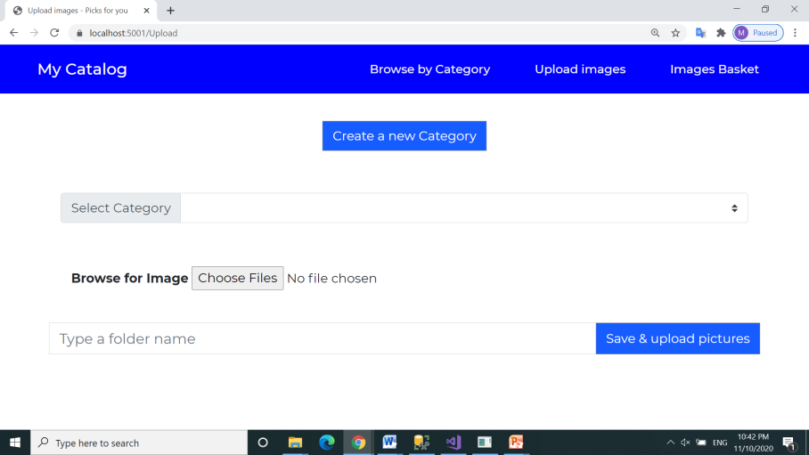
Add a new Category

Slide 5
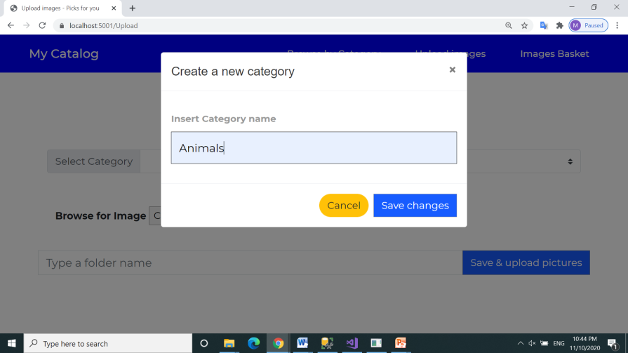
Confirm new Category - Animals

Slide 6
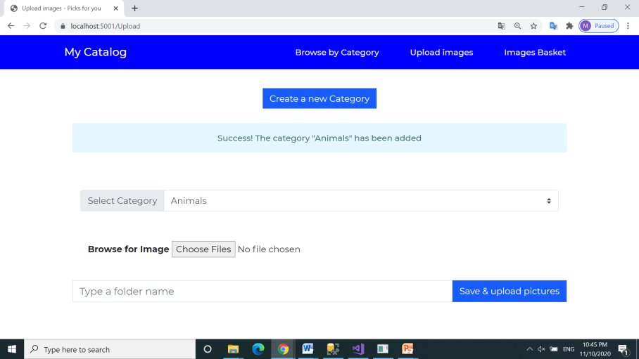
Select category Animals from picklist and click to add image

Slide 7
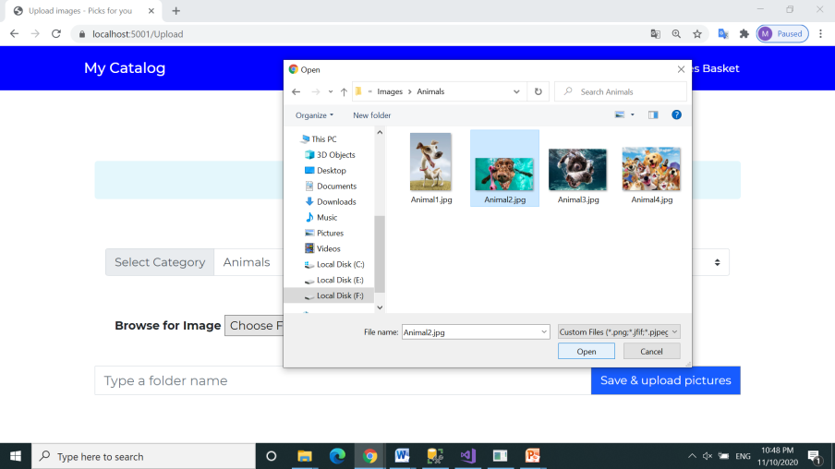
Select file from local disk and click open

Slide 8
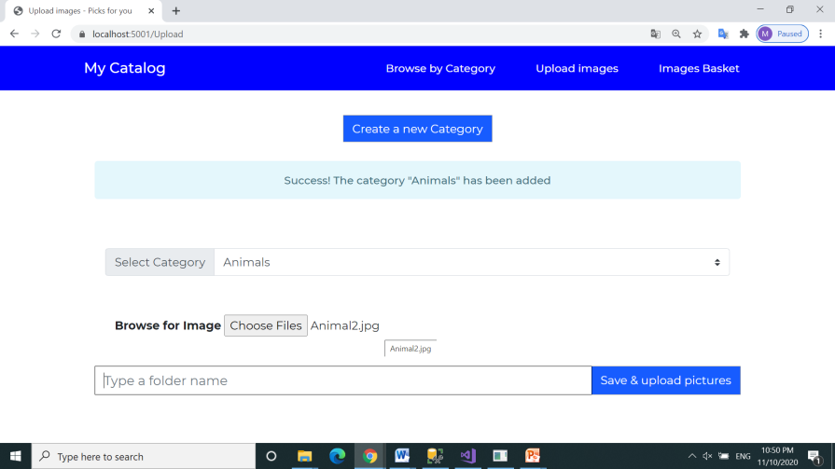
Animal2.jpg file is now selected

Slide 9
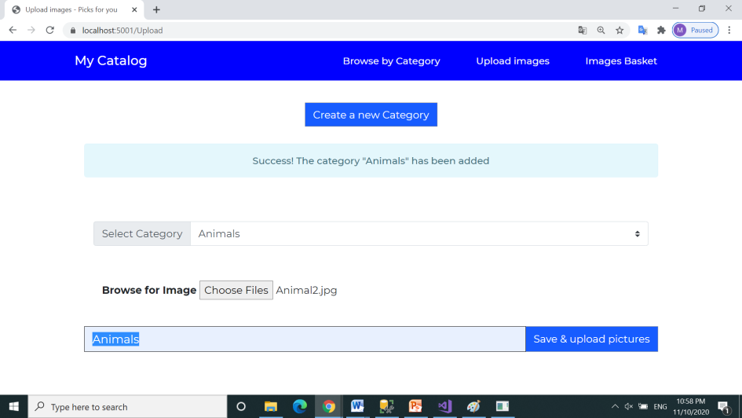
Add a folder name: “Animals” and click
on “Save & upload” pictures button

Slide 10
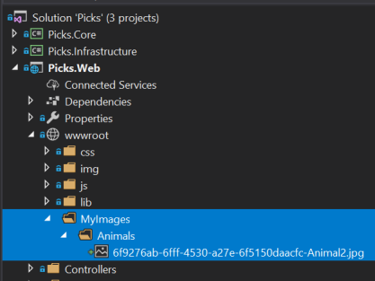
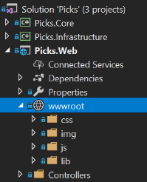
A new folder “MyImages” and a new subfolder “Animals” were automatically created in wwwroot
The file name was renamed: Guid + filename.jpg (see Picks.Infrastructure.Repositories.DataRepository.cs)

Slide 11
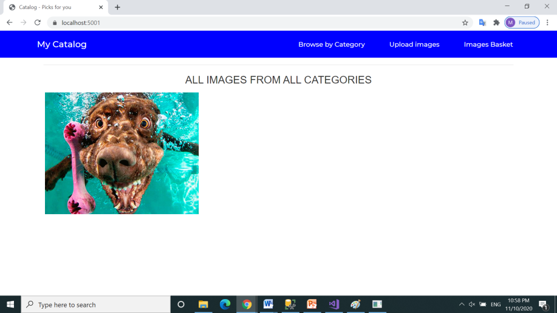
Click on link Browse by Category

Slide 12
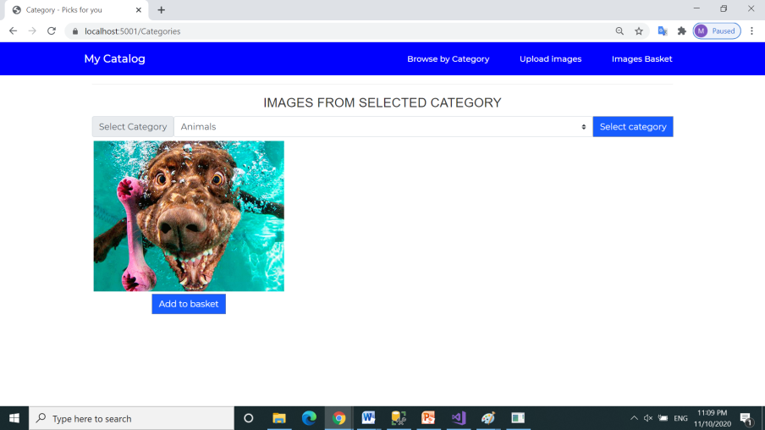
Click Add to basket button

Slide 13
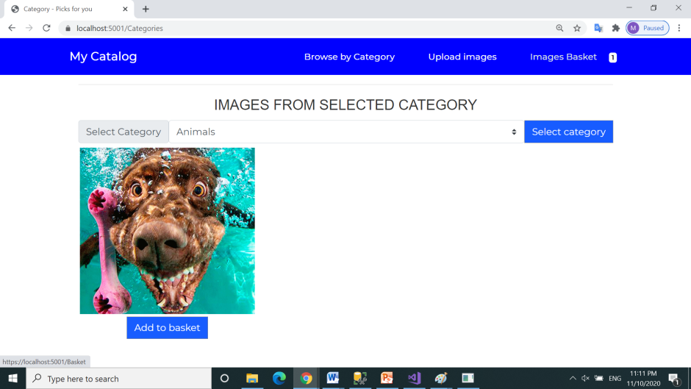
Images Basket contain new a picture (1)
Click on Images Basket link

Slide 14
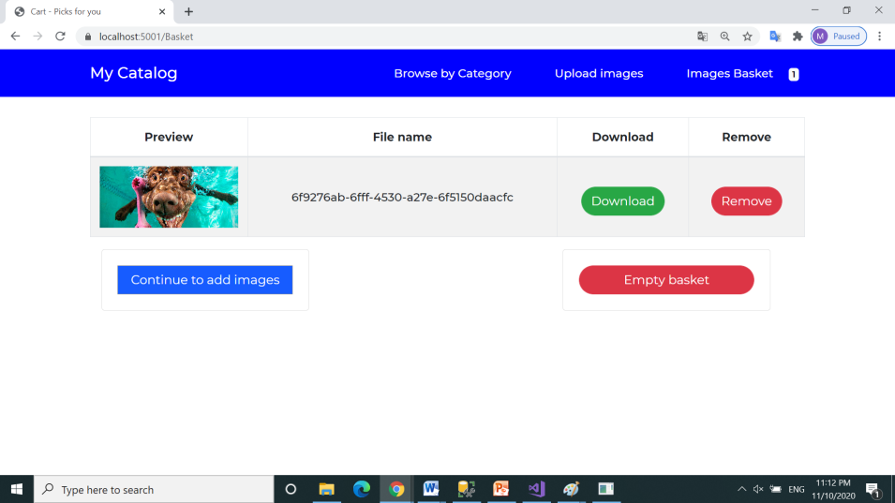
Images Basket contain new a picture
Click on Download button to download the image on computer

Slide 15
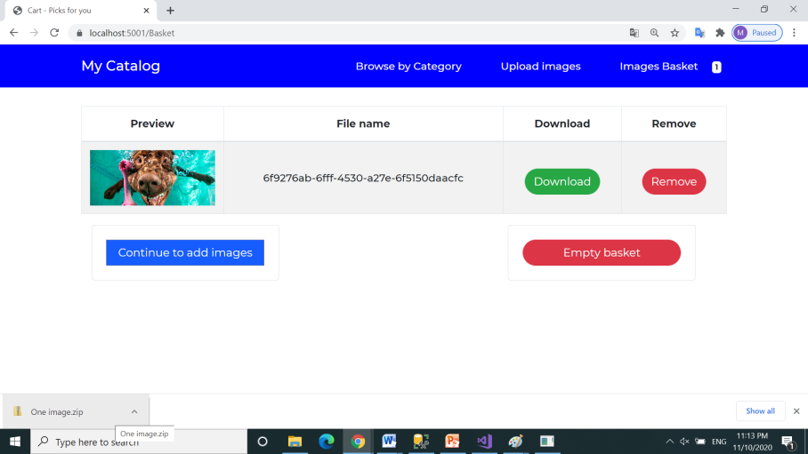
A image zip file was downloaded

Slide 16
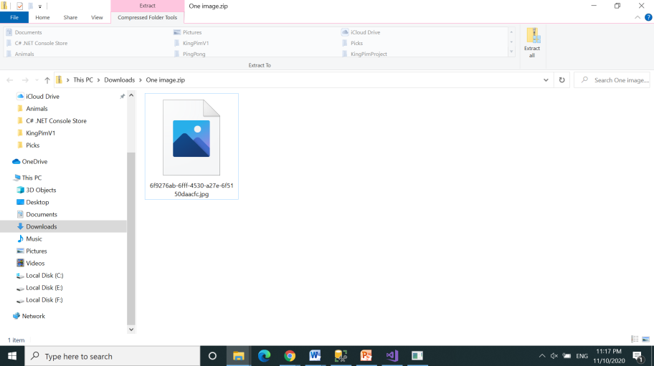
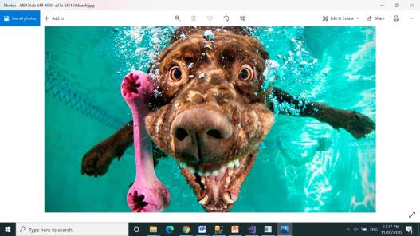
Open the folder One image.zip which contains the downloaded file
in Downloads folder

Slide 17
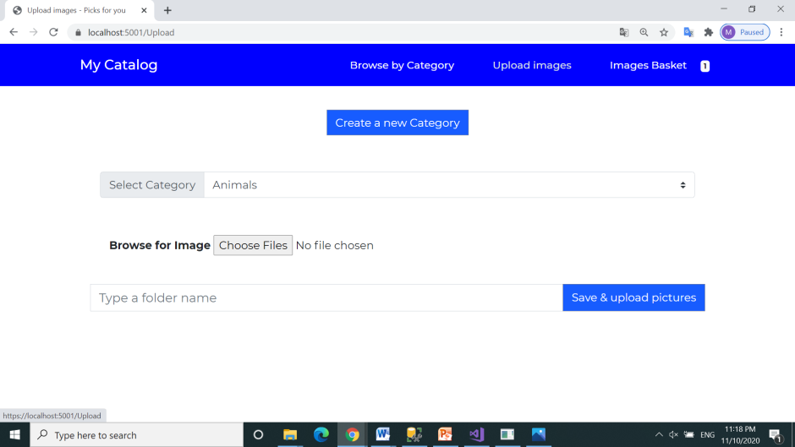
Add a new Category

Slide 18
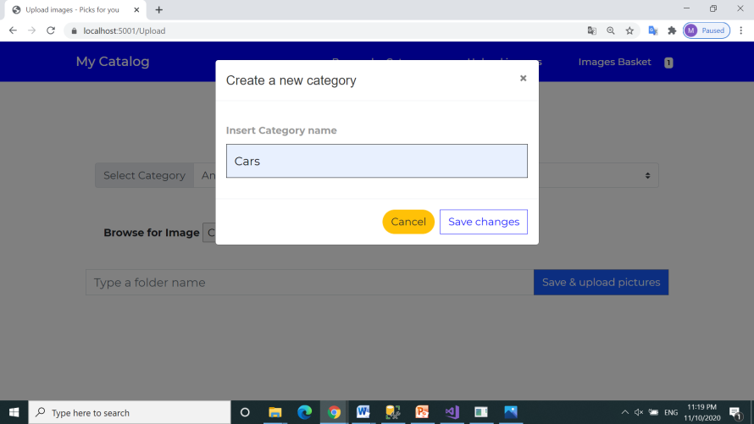
Confirm new Category - Cars

Slide 19
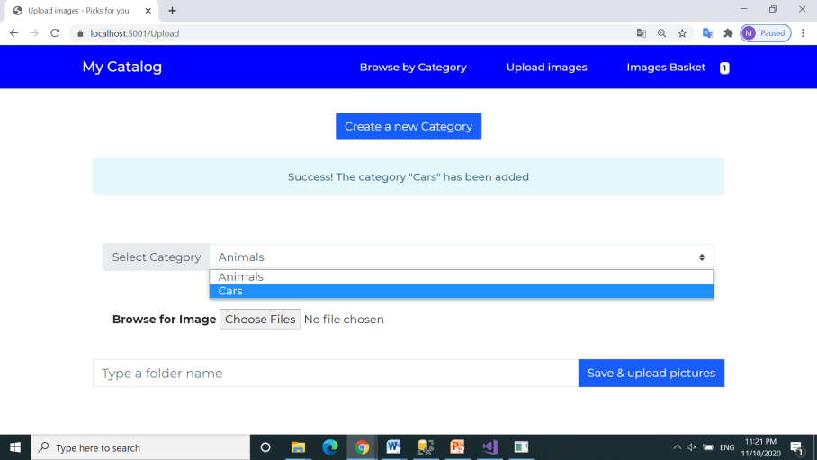
Select category Cars from picklist and click to “Choose Files” button
to add more images

Slide 20
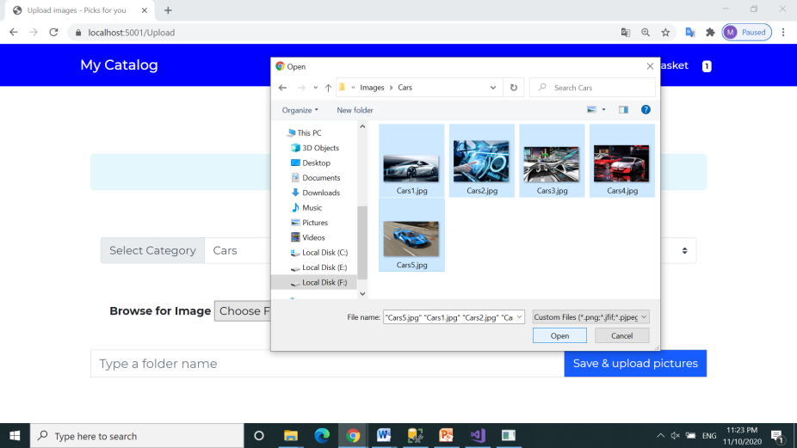
Select all five files from Cars folder and click open

Slide 21
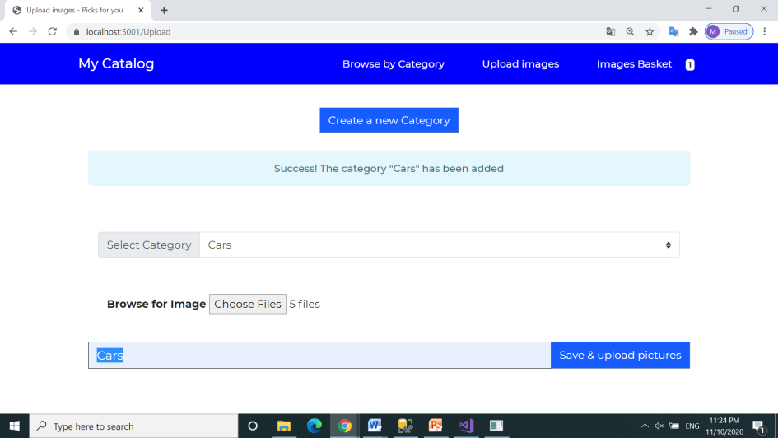
Five jpg files are now selected
Add a folder name: “Cars”

Slide 22
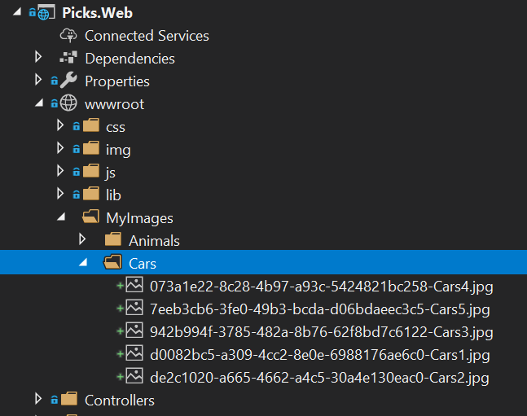
A new subfolder “Cars” were automatically created in path wwwroot/MyImages
The file names was renamed: Guid + filename.jpg (see Picks.Infrastructure.Repositories.DataRepository.cs)

Slide 23
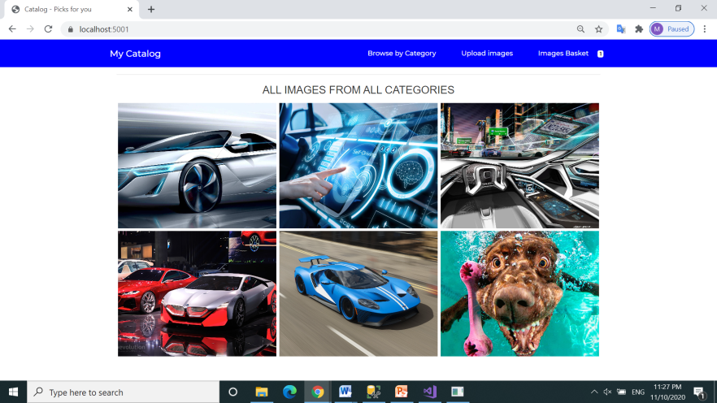
Automatically return to home page
Click on first image to open it

Slide 24
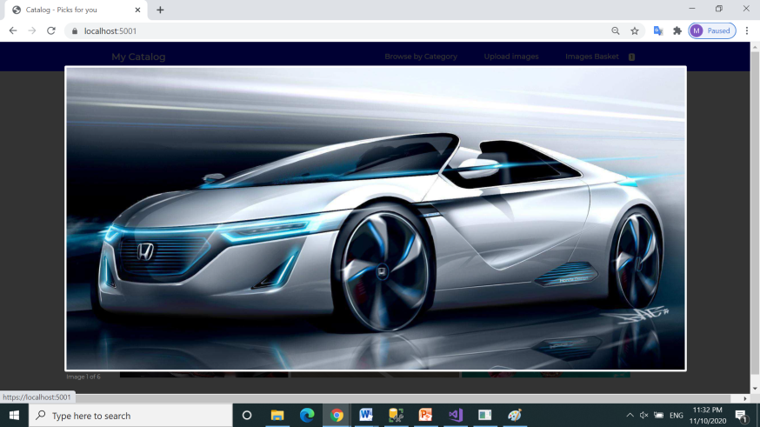
Click direct on the image to have access to the other images

Slide 25
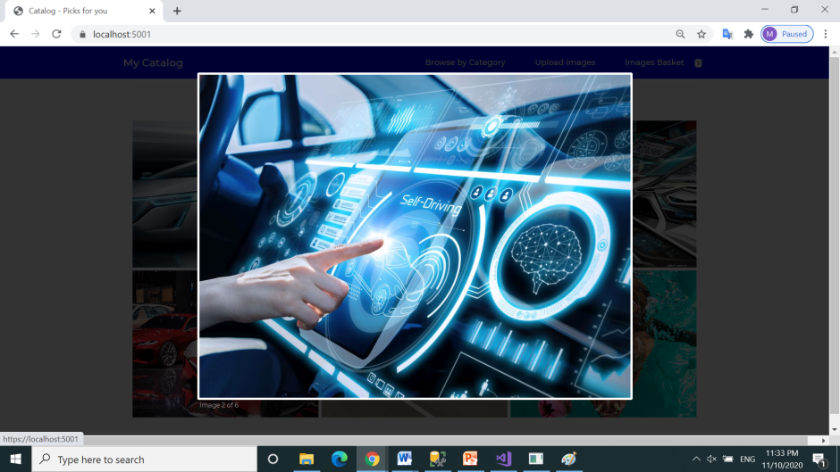
Then , click Esc to return to Home page

Slide 26
Click Browse by Category

Slide 27
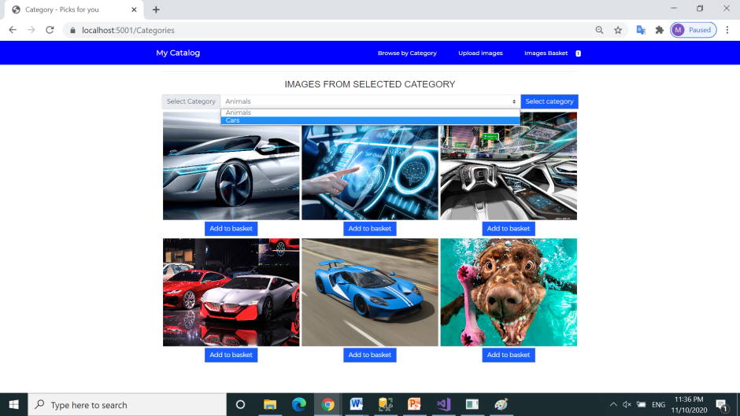
Select “Cars” category from picklist, then click Select category

Slide 28
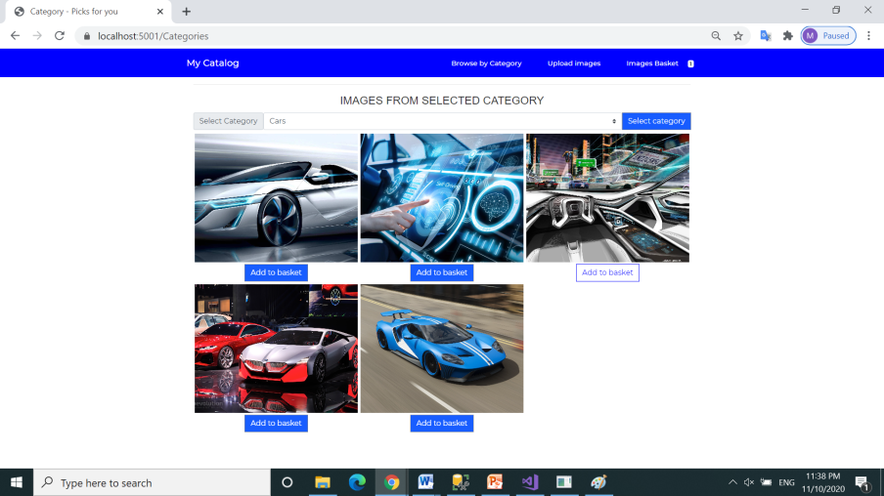
List of category selected: Cars
Click “Add to basket” button to add a new image in basket

Slide 29
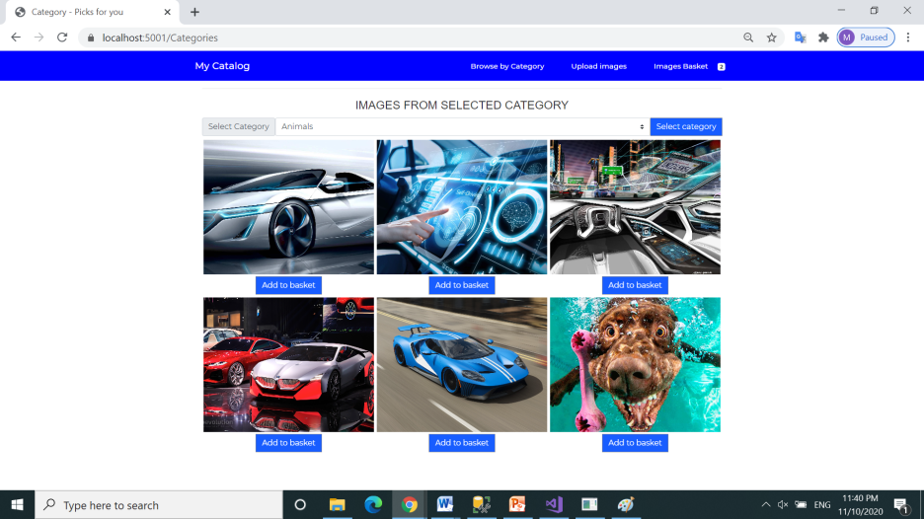
A new image was added to basket and then return to Categories
Now we have two images in basket (2)
Click then to add the third image to basket, and click on Images basket (3)

Slide 30
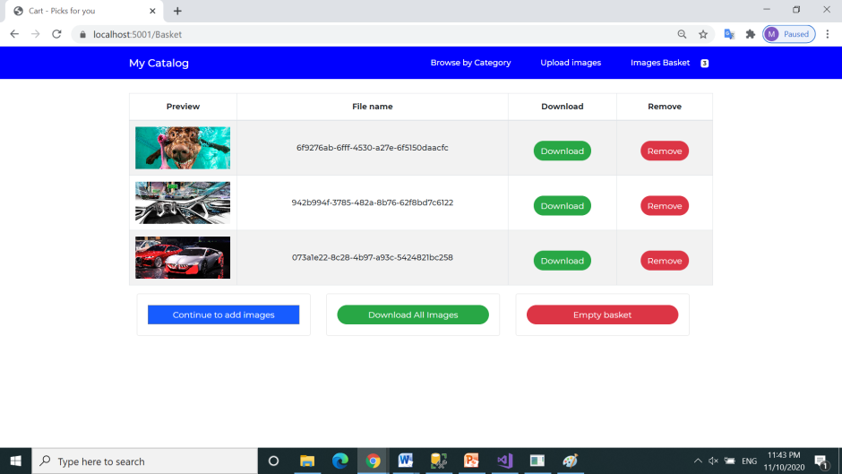
Images Basket contain 3 new pictures
Click to remove first image

Slide 31
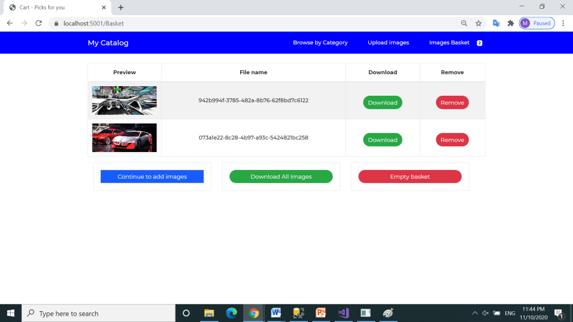
In Images Basket remains 2 pictures
Click to Download All Images

Slide 32

A multiple images zip file were downloaded

Slide 33
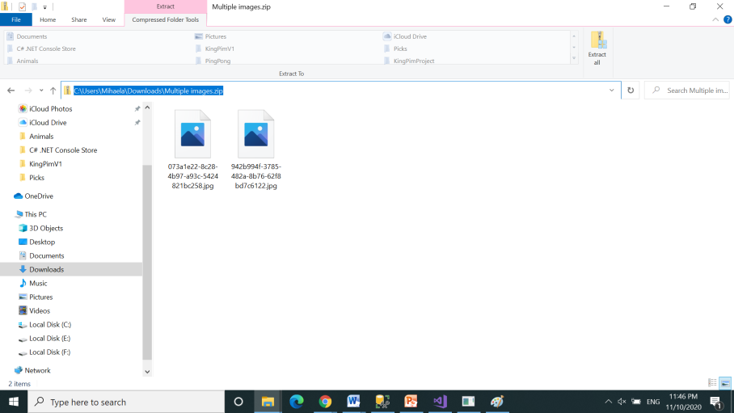
Open the folder Multiple images.zip which contains the downloaded files
in Downloads folder

Slide 34
Remove all images from basket

Slide 35
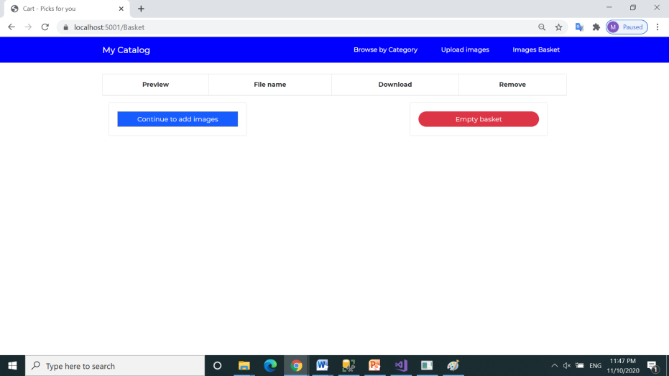
Return back to Home Page – My catalog

Slide 36

Basket is now empty
Return to Home page – My Catalog
Thanks !

